Slide 1
Monitoring employees

Slide 2
Monitoring employees
Businesses may wish to know where their employees are at any given moment or where they have been, or they may wish to monitor the communications made by their employees.
Businesses can monitor employees in a number of different ways:
GPS tracking Electronic tagging
Monitoring internet use and communications
Email monitoring Company policies

Slide 3
GPS tracking
Global Position Systems (GPS) use satellites that transmit data about their positions and the time to GPS receivers, which use the data to calculate the location of the receiver on the Earth’s surface.
The GPS receivers require data from at least four satellites to locate their position. The data can be used to navigate to other positions (satellite navigation) or to track (GPS tracking device) items such as the location of mobile phones or vehicles.

Slide 4
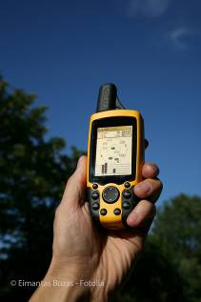

GPS tracking device
GPS tracking devices can be hand-held:
… or fitted permanently to vehicles:

Slide 5






GPS tracking of vehicles
A GPS tracking device fitted permanently to a vehicle will have a battery backup and will send data about its location to a company server using e.g. the mobile phone network. Once received, the location data can be viewed onscreen to show where the vehicle has been, and where it is now.
Server gets data from GPS device
Data can be accessed on mobile devices via the internet
Internet
Data can be sent via internet
GPS tracking device in truck gets data from satellites and sends it to phone network

Slide 6
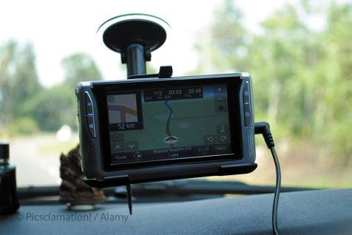
Satellite navigation
Satellite navigation systems use GPS to locate their position and to provide directions, and traffic information if access to this is set up, to drivers using a suitable satellite navigation device (a ‘SATNAV’).
These devices do not provide the data for tracking as they do not transmit their data.

Slide 7

Electronic tagging
Employers would not use electronic tagging to track their employees.
This type of tagging is usually reserved for tracking offenders.

Slide 8
Monitoring internet use and communications
Companies monitor employees’ use of the internet and their communications because they have a responsibility to ensure that any use of the internet and all communications by employees while at work are work-related, and are appropriate.
Monitoring is usually done by keeping logs and reports of all internet access and communications.

Slide 9

Email monitoring
Employers monitor the emails of their employees to ensure that all emails are appropriate and will not lead the company into disrepute, and for reference if there is a dispute with a client or supplier. The emails themselves are kept and there is often a log of all the emails sent or received by employees.

Slide 10


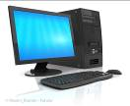



Keeping logs and reports of employees’ internet activities
Employees’ computers and devices
Server
Firewall
Internet
Network activity
Charts etc viewed on computers
Access monitor software
shows charts and reports
Log files

Slide 11
Company policies
John Smith
Digital Manager, Projects & Services
Hodder Education
338 Euston Road
London
NW1 3BH
john.smith@hodder.co.uk
This email is intended solely for the above mentioned recipient and may contain confidential or privileged information. If you have received this email in error you are on notice of its status and please notify us immediately and delete the email. You must not copy, distribute, disclose or take any action in reliance on it: to do so may be a breach of confidence. Any views expressed in this email and any attachment are those of the individual sender and are not necessarily agreed or authorised by Hodder Education. While every reasonable precaution is taken to minimize the risk of viruses contained within this email, we cannot accept liability for any damage which you sustain as a result of software viruses. It is advised that you carry out your own virus check before opening any attachments.
Businesses should have a company policy regarding emails, and this should be made available to all employees.
Often there is also a company policy statement that is attached to all emails that are sent from the business.

